Slide 1

JavaScript Fundamentals
Course Introduction
SoftUni Team
Technical Trainers
Software University
https://softuni.bg/

Slide 2
Table of Contents
Introduction
Course Objectives
Trainers and Team
Course Details

Slide 3
Have a Question?
sli.do
#fund-js

Slide 4












SoftUni Diamond Partners

Slide 5


Educational Partners

Slide 6
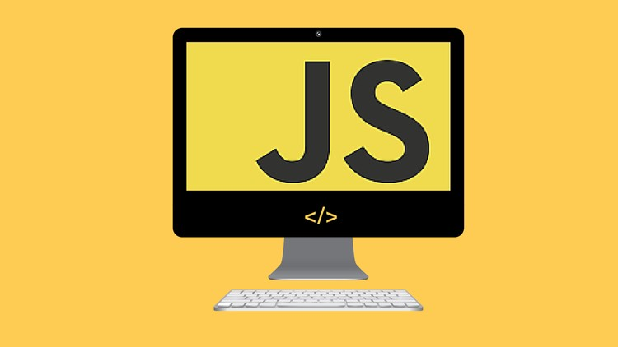
JS Fundamentals
Course Objectives

Slide 7
Course Objectives
Extends the Programming Basics course
Fundamentals coding skills for the JS language
Use of more complex techniques and structures such as arrays, classes, and objects
Ability to solve algorithmic problems
Introduction to the basics of web development

Slide 8
JS Fundamentals – Course Topics
Basic Syntax, Conditional Statements And Loops
Data Types and Variables
Arrays
Functions
Arrays Advanced
Objects and Classes
Associative Arrays
Text Processing
Regular Expressions

Slide 9

Trainers and Team

Slide 10
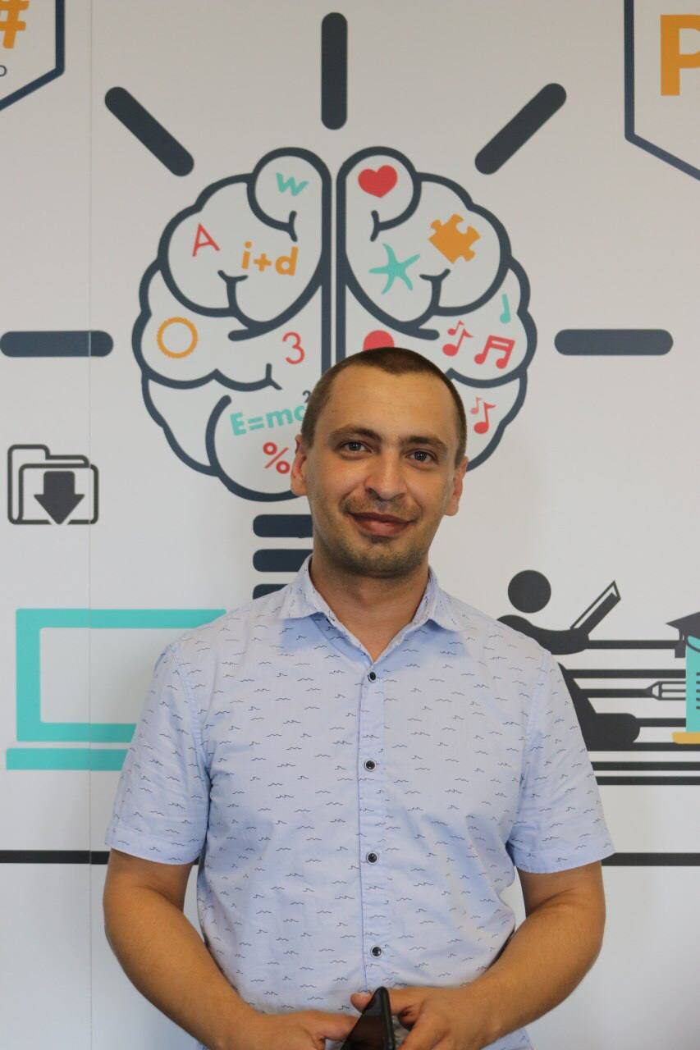
Todor Stoyanov
Front End Developer at SAP
4+ years of experience as a Technical Trainer at Software University
Experience JS, React.js, Angular, and Java

Slide 11
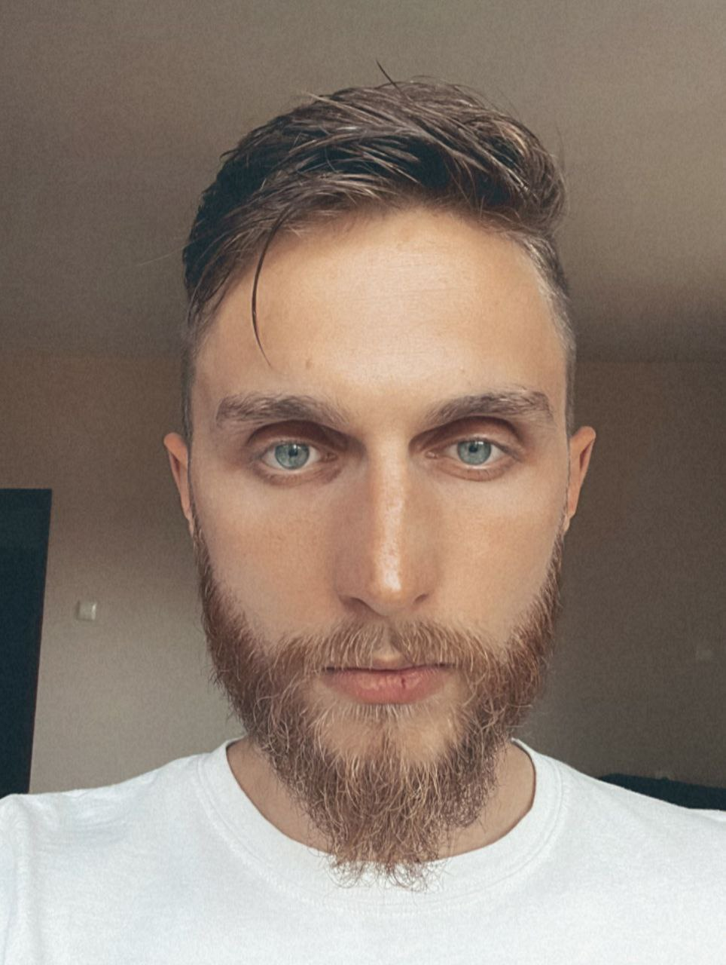
Ivaylo Dimitrov
Software Engineer at EPAM Systems
4+ years of experience as a Technical Trainer at Software University
Front-end development
Lecturer in various conferences and seminars

Slide 12

Course Details
Schedule

Slide 13

Practical Programming Exam
Mid Exam
3 practical problems for 4 hours
Conditional Statements and Loops
Linear Data Structures – Arrays
Final Exam
3 practical problems for 4 hours
Associative Arrays
Strings and Text Processing
Regular Expressions
Link to Exams

Slide 14
Theoretical Exam
20 questions for 30 minutes
Multiple choice
English
Automated quiz system
Available online – open when the practical exam starts and active 30 minutes after its end
You can submit your answers just one time

Slide 15
JS Fundamentals Module Timeline
JS Fundamentals
12 weeks
3 times per week
12 credits
Start: 16. May 2022
Mid-Exam: 26. Jun 2022 Final-Exam: 07. Aug 2022
Exam Retakes
Mid-Exam: 11. Aug 2022 Final-Exam: 15. Aug 2022
16.
26.
07.
May
June
July
August

Slide 16
Course Scoring
Practice grade:
Theory grade:
SoftUni Certificate: 5.00 from Practice
CPE Certificate: 3.00 average from Practice + Theory
Practical Mid Exam
Practical Final Exam
Homework
40 %
60 %
+5 %
Theoretical Exam
100 %
16

Slide 17

Homework Assignments & Exercises
Your homework is mainly work in class
Lesson days → slides + live demos + exercises
Exercise days → only exercises
How to submit your homework?
Submitted in the judge system
Do your homework when it's due
Assignments pile up quickly

Slide 18




Course Web Site, Forum
Official web site:
Official discussion forum:
Official JavaScript Facebook group:
Official SoftUni JavaScript Community:
softuni.bg/trainings/3732/programming-fundamentals-with-javascript-may-2022
softuni.bg/forum/programming-fundamentals
facebook.com/groups/ProgrammingFundamentalswithJavaScriptMay2022
facebook.com/groups/SoftUniJavaScriptCommunity

Slide 19
Questions?
Notes:
19

Slide 20
Trainings @ Software University (SoftUni)
Software University – High-Quality Education, Profession and Job for Software Developers
softuni.bg
Software University Foundation
softuni.foundation
Software University @ Facebook
facebook.com/SoftwareUniversity
Software University Forums
forum.softuni.bg
Notes:
20

Slide 21

License
This course (slides, examples, demos, exercises, homework, documents, videos and other assets) is copyrighted content
Unauthorized copy, reproduction or use is illegal
© SoftUni – https://softuni.org
© Software University – https://softuni.bg
Notes:
21

